Slide 1

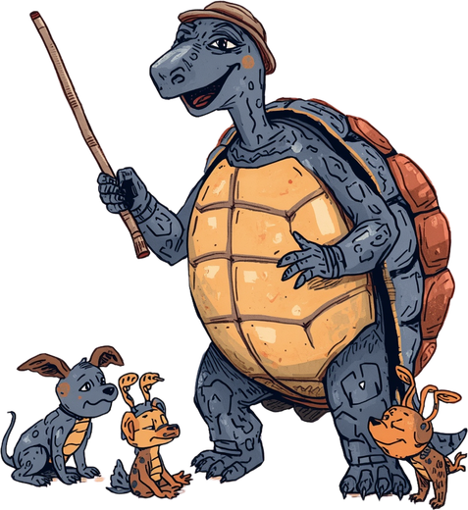




BRINGING DATA STRUCTURES & ALGORITHMS TO LIFE
Interactive Website with Step-by-Step Visualizations

Slide 2




OUR SOLUTION: AN INTERACTIVE VISUAL WEBSITE
Like a wise storyteller from the Panchatantra tales, our website guides students through Data Structures & Algorithms concepts with engaging, step-by-step animations. Each concept unfolds like a fable—clear, memorable, and meaningful.
Key Features:
• Step-by-step visual animations for each concept
• User controls to pause, play, and navigate at your own pace
• Interactive visual aids that bring abstract ideas to life
• Storytelling approach that makes learning enjoyable

Slide 3
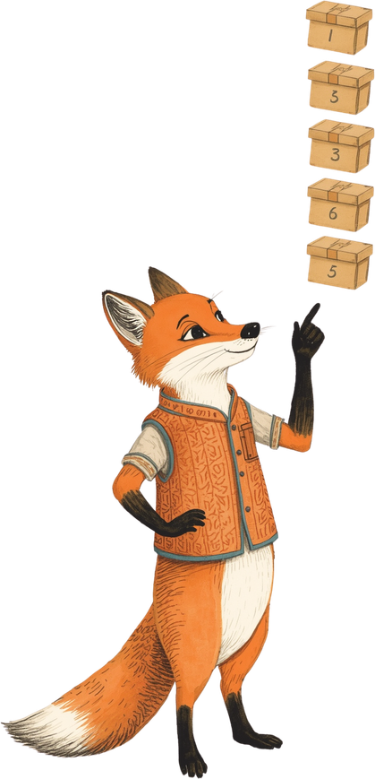



BINARY SEARCH EXPLAINED
Binary Search is a clever algorithm that finds elements in a sorted array by repeatedly dividing the search space in half. Like a wise fox hunting for treasure, it starts in the middle and asks: "Is my target higher or lower?" Each comparison eliminates half the remaining possibilities, making it remarkably efficient with O(log n) time complexity. Instead of checking every element one by one, Binary Search narrows down to the answer in just a few strategic steps—turning a potentially long search into a swift, intelligent journey to the solution.

Slide 4
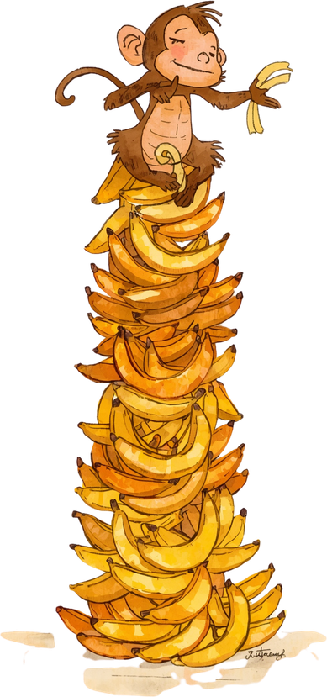


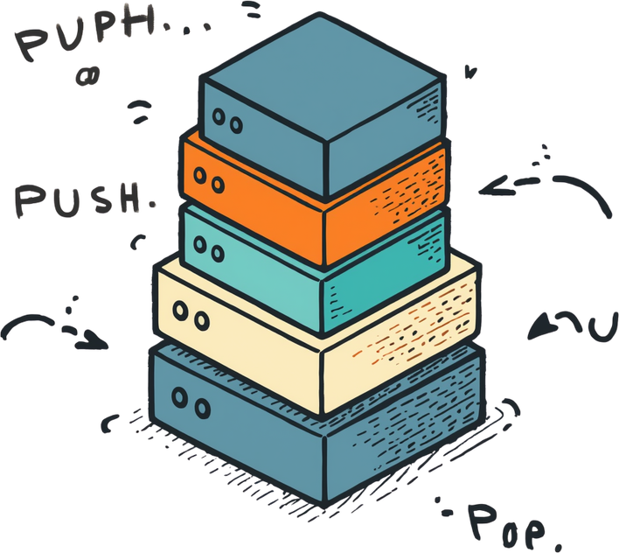
UNDERSTANDING STACK
A Stack follows the Last-In-First-Out (LIFO) principle—like stacking plates, the last item added is the first to be removed. Key operations include Push (add to top) and Pop (remove from top). Our interactive visualization demonstrates these operations step-by-step, showing how elements enter and exit the stack in real-time. Watch as data flows through the structure, making abstract concepts tangible and memorable.

Slide 5





LINKED LIST VISUALIZATION
A Linked List is a linear data structure where elements called nodes are connected in sequence. Each node contains data and a pointer to the next node, forming a chain. Unlike arrays, linked lists allow efficient insertion and removal of elements at any position without shifting other elements. Our interactive animation demonstrates how nodes link together, showing insertion at the head, tail, or middle, and how removal reconnects the chain seamlessly. Watch as each node finds its place in the sequence, guided step-by-step through the process.

Slide 6




BINARY TREE ILLUSTRATION
A Binary Tree is a hierarchical data structure where each node has at most two children—left and right. Like branches of a great banyan tree, data flows from root to leaves. Tree traversals (Inorder, Preorder, Postorder) visit nodes in specific orders, each revealing the structure differently. Our animation shows how traversal algorithms navigate through nodes, highlighting each step as wise birds hop from branch to branch, teaching the path of knowledge.

Slide 7



HOW USERS INTERACT
Key Controls: Select your concept from the menu, then use start, pause, and reset buttons to control the animation. Step through each stage at your own pace to fully understand the process.
User Flow: Select concept → Watch animation → Control playback. As the Panchatantra wisdom teaches, "The learner guides the story at their own pace" – explore DSA concepts like a curious student with a wise teacher.

Slide 8


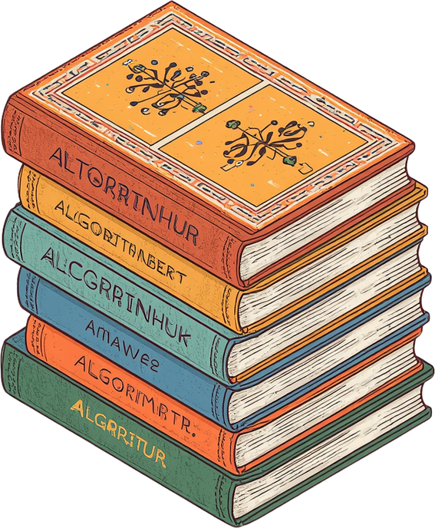
BENEFITS FOR STUDENTS
Makes DSA Accessible & Clear
Interactive Visuals Aid Comprehension
Self-Paced Learning with Control
Supports Diverse Learning Styles

Slide 9






THANK YOU!

